Slide 1
AI TRAVEL PLANNER AGENT
IBM AICTE PROJECT
Presented By:
Student name : Gogula Venkata Ramana
College Name & Department : JNTUA College Of Engineering Pulivendula-computer science and engineering

Slide 2
OUTLINE
Problem Statement
Technology used
Algorithm & Deployment
Result
Git-hub Link
Conclusion
IBM Certifications

Slide 3
PROBLEM STATEMENT
Challenge:
Travel planning is often fragmented, time-consuming, and stressful. Users struggle to find optimal destinations, accommodations, and transport options that match their preferences and budget.

Slide 4
TECHNOLOGY USED
- IBM Cloud Lite Services
- Natural Language Processing (NLP)
- Prompt Engineering with IBM Granite
- IBM Cloud Services Used:
- IBM Watsonx AI Studio
- IBM Watsonx AI Runtime
- IBM Cloud Agent Lab
- IBM Granite Foundation Model

Slide 5
ALGORITHM & DEPLOYMENT
Step by step procedure:
An AI-powered Travel Planner Agent that:
Understands user preferences, budget, and constraints
Suggests destinations, builds itineraries
Recommends transport and accommodation
Integrates maps, weather updates, and local guides
Manages bookings and alerts users to changes
-Optimizes schedules dynamically for a smooth travel experience

Slide 6
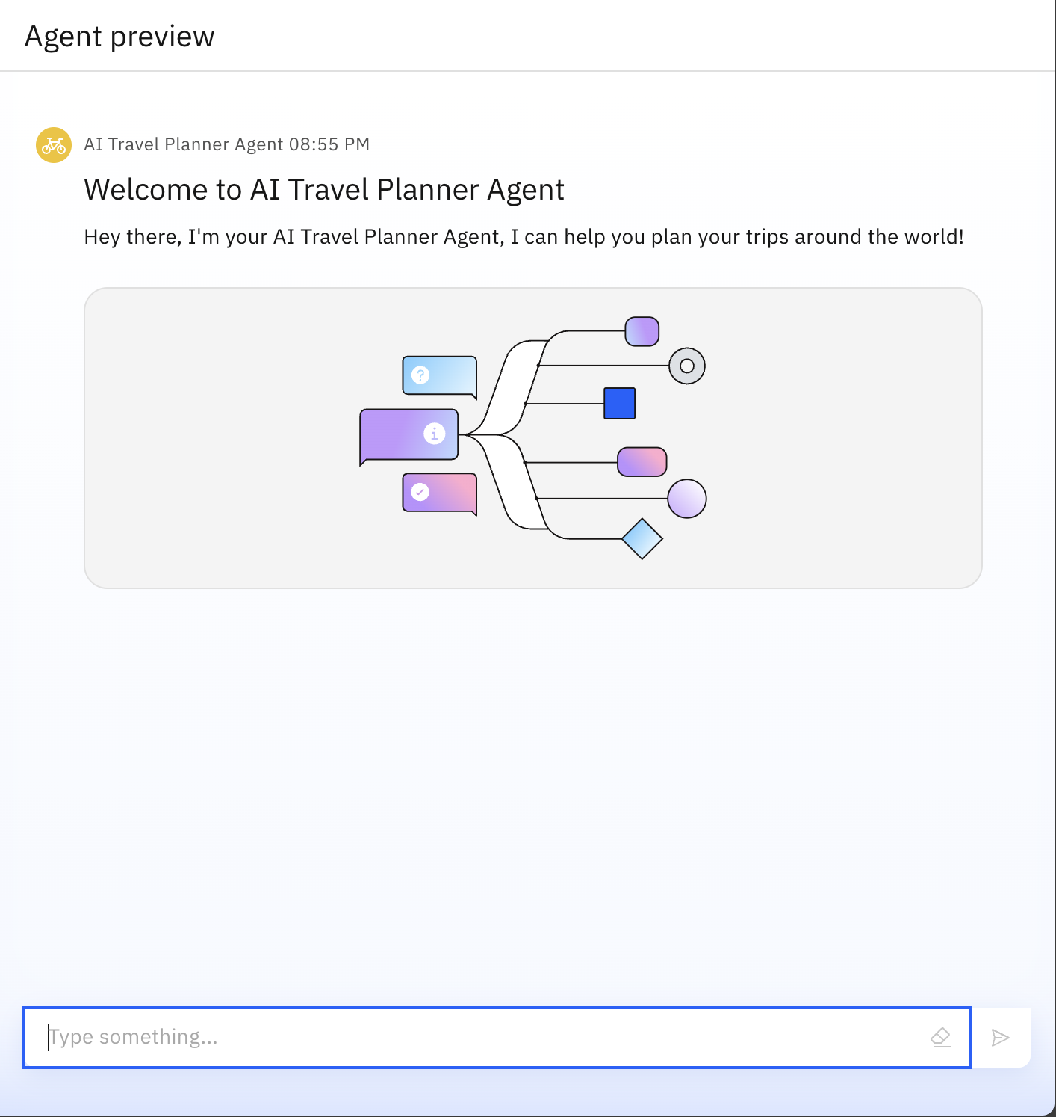
RESULTS

Slide 7
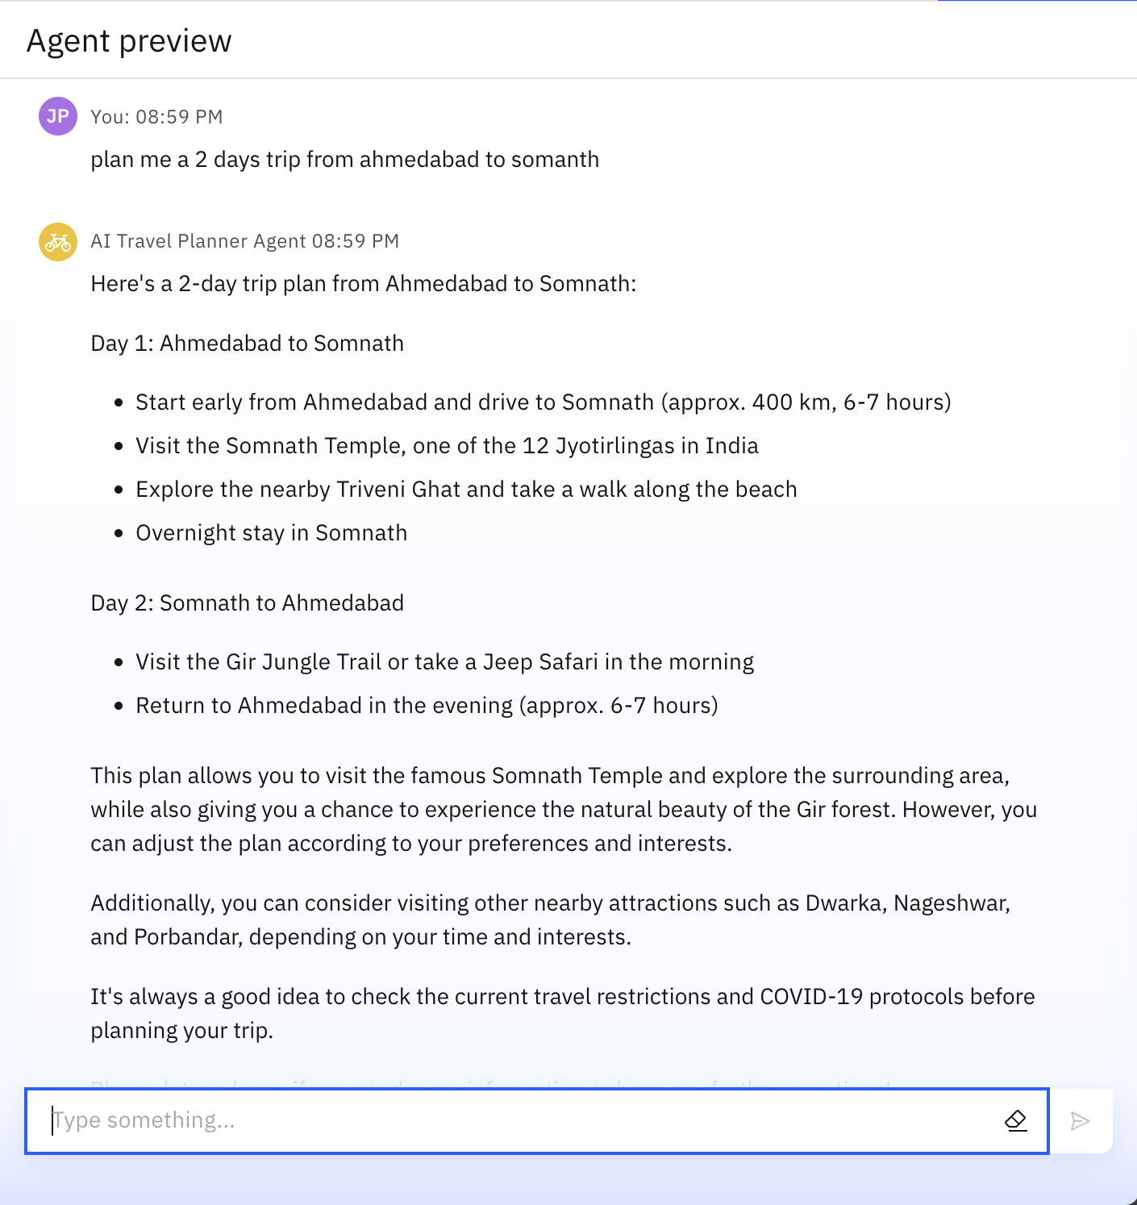
RESULTS

Slide 8
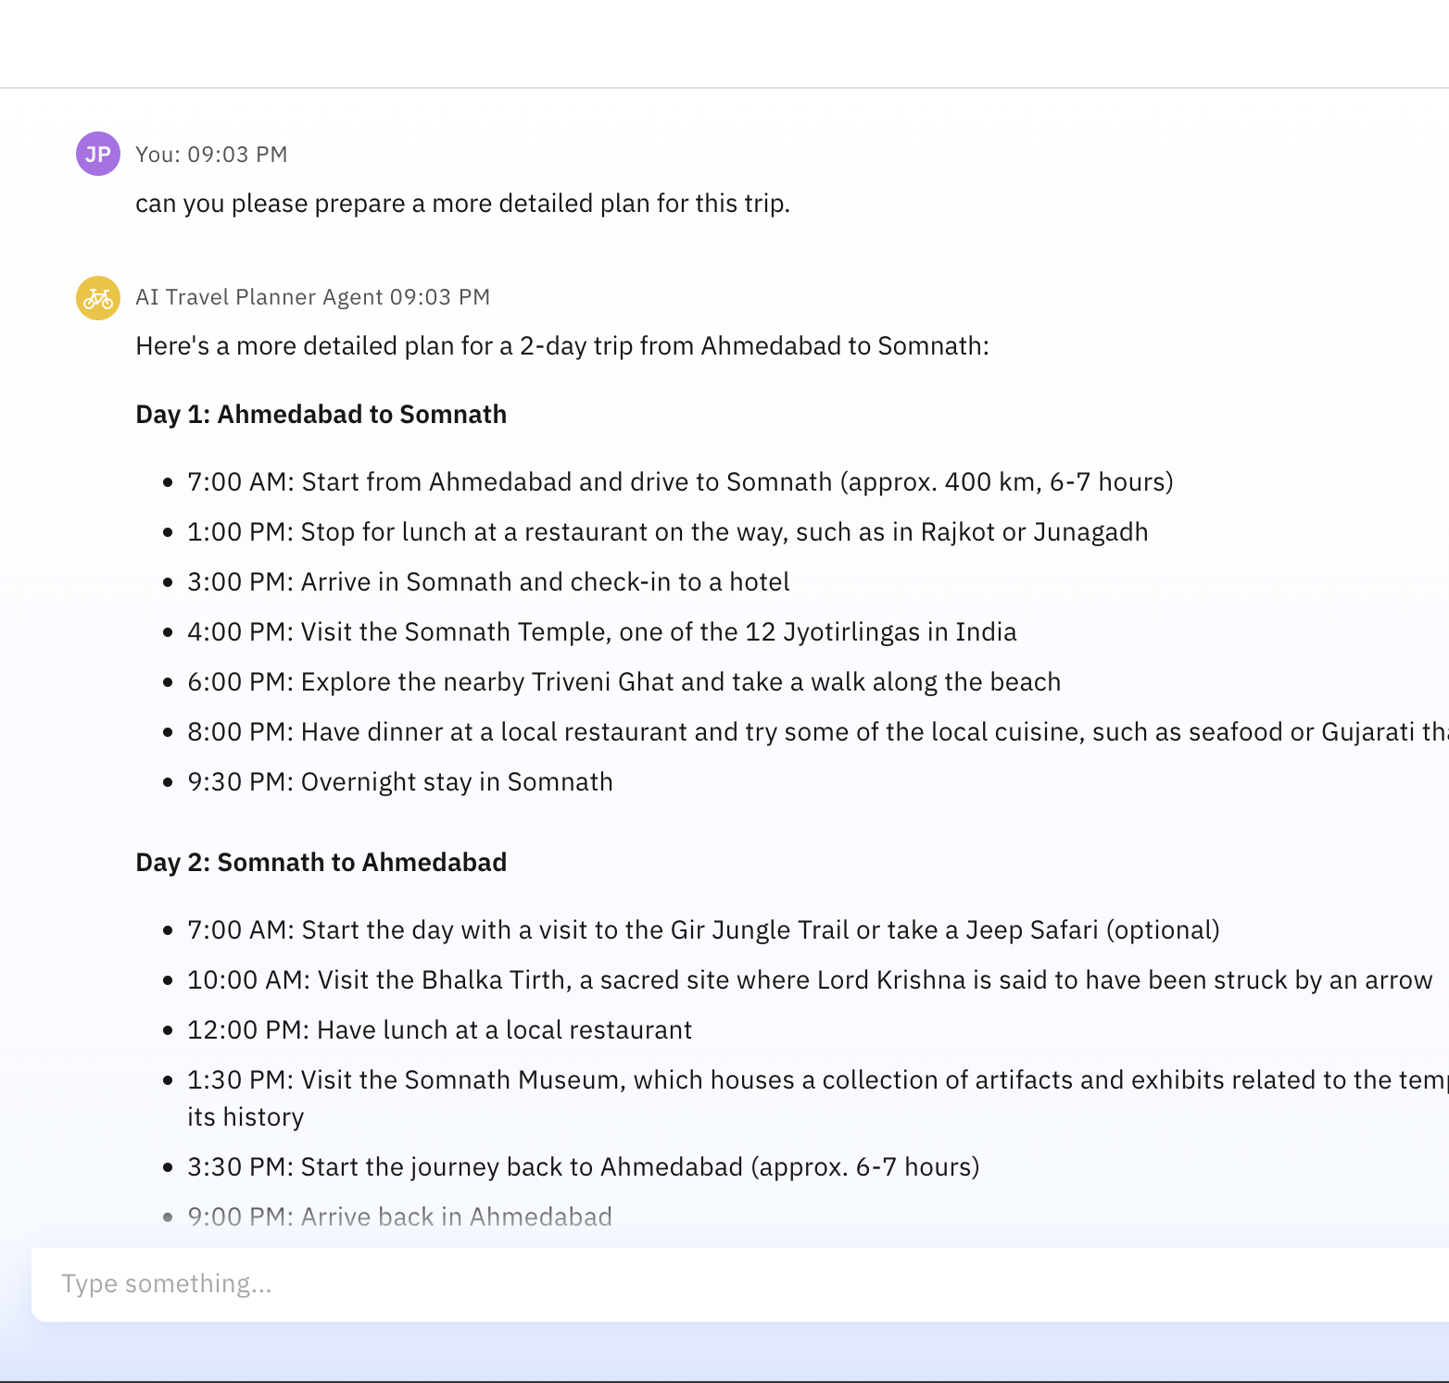
RESULTS

Slide 9
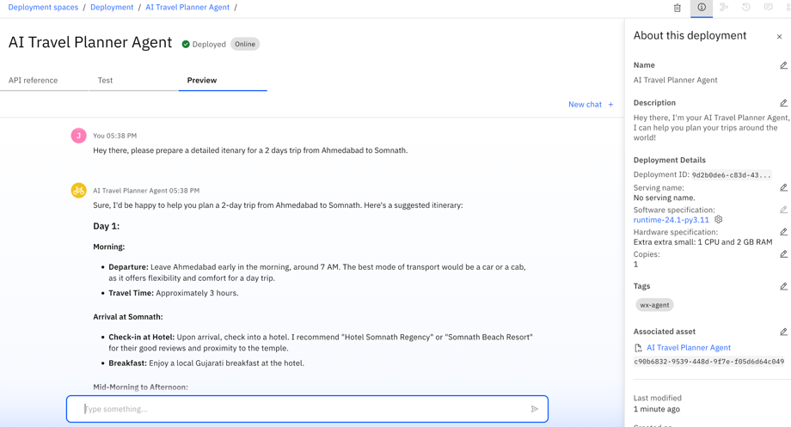
RESULTS
Deployed AI Agent

Slide 10
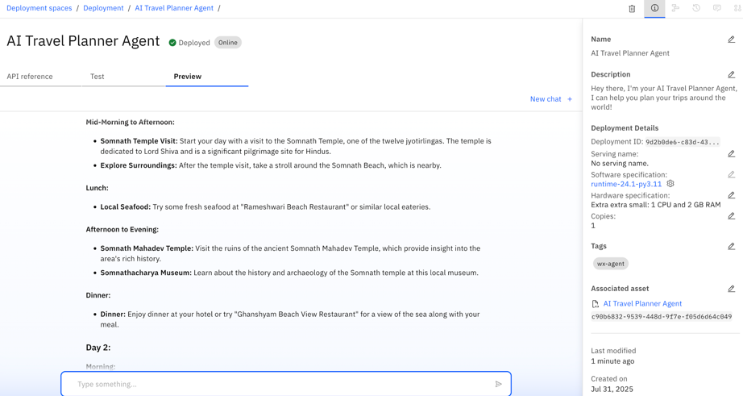
RESULTS
Deployed AI Agent

Slide 11
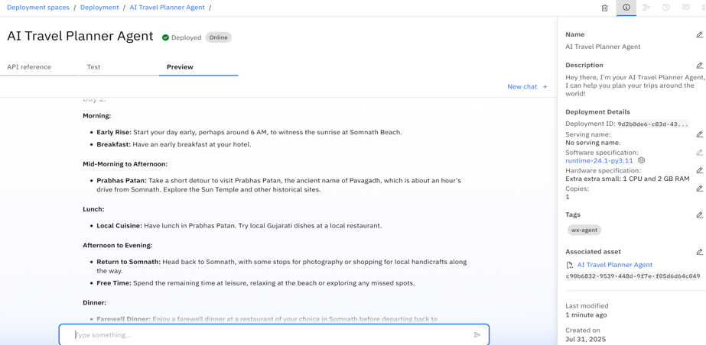
RESULTS
Deployed AI Agent

Slide 12
GITHUB LINK
https://github.com/Ramana531664/AI-Cloud.git

Slide 13
CONCLUSION
The Travel Planner Agent simplifies trip planning using AI
Enhances user experience with personalization and automation
Leverages IBM Cloud and Granite for scalable, intelligent solutions
Demonstrates real-world impact of AI in consumer applications

Slide 14
FUTURE SCOPE
Multilingual Travel Support
Voice-Activated Travel Assistant
Real-Time Group Collaboration Features
Sustainable Travel Recommendations
Integration with Booking & Review Platforms
AI-Assisted Travel Blog Drafting

Slide 15
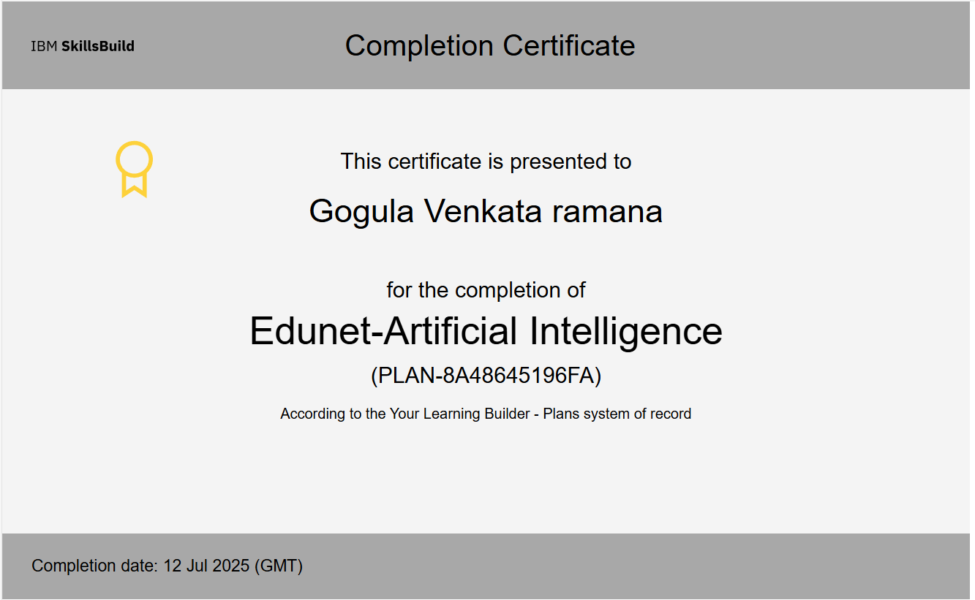
IBM CERTIFICATIONS

Slide 16
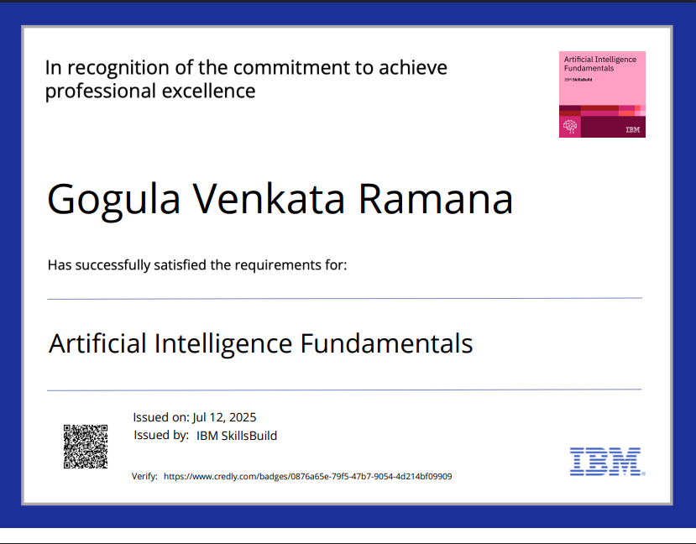
IBM CERTIFICATIONS

Slide 17
THANK YOU

